Slide 1
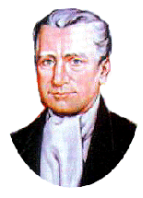
Blessed Edmund Rice &
Presentation Brothers Today!

Slide 2
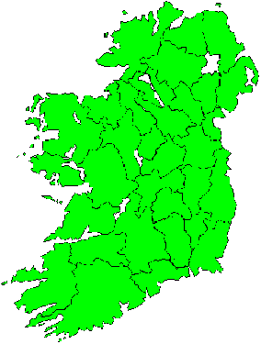
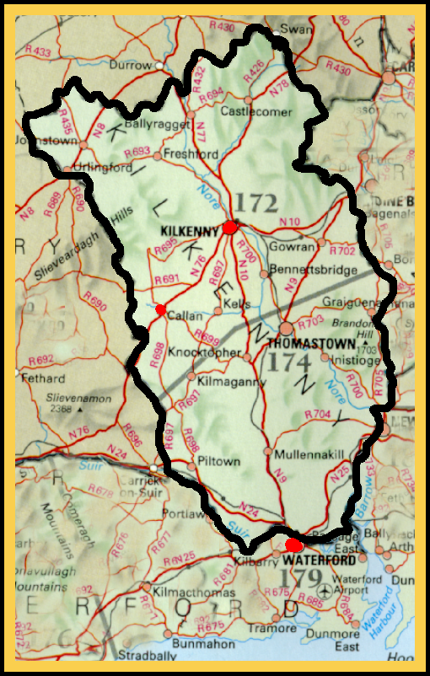
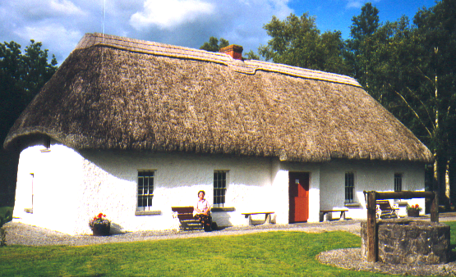
Callan
Edmund Rice was born in this house near Callan in Co. Kilkenny, on 1st June 1762.

Slide 3
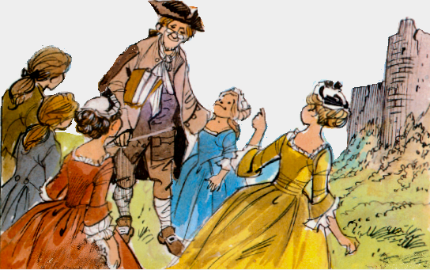
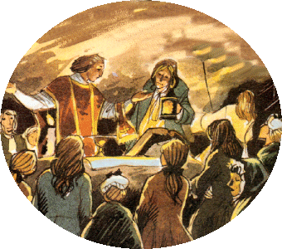
The Penal Laws
1695-1829

Slide 4
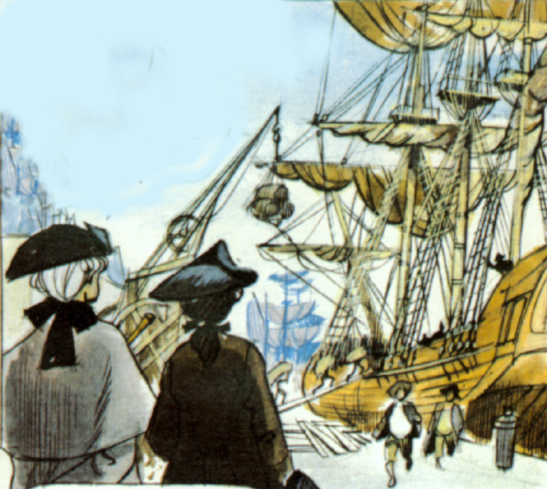
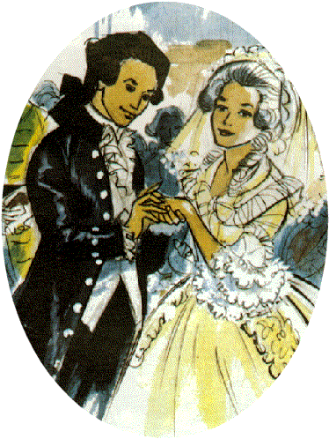
Waterford
Marriage

Slide 5
But tragedy strikes…..
.
A Crossroads for Edmund………

Slide 6
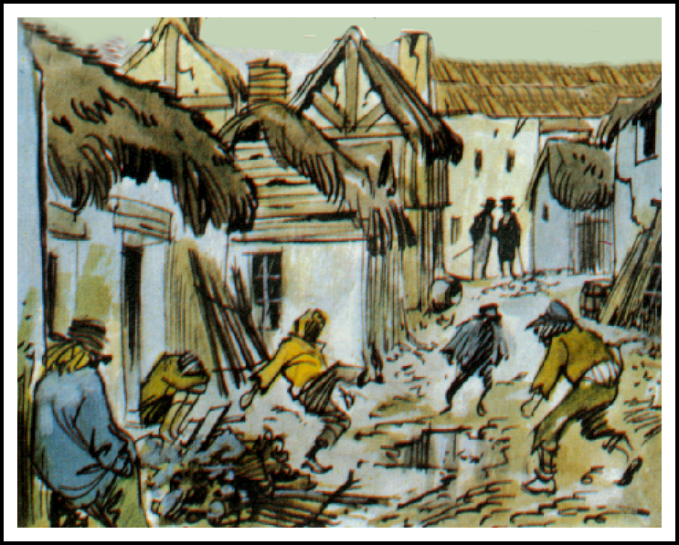
What will I do with my life????

Slide 7
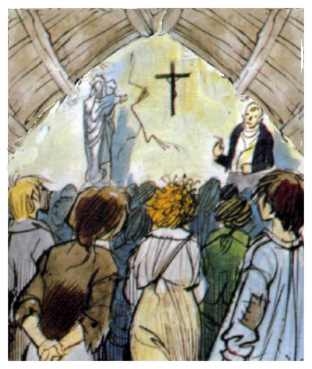
Millionaire Businessman Sells All and……
Waterford
1802

Slide 8
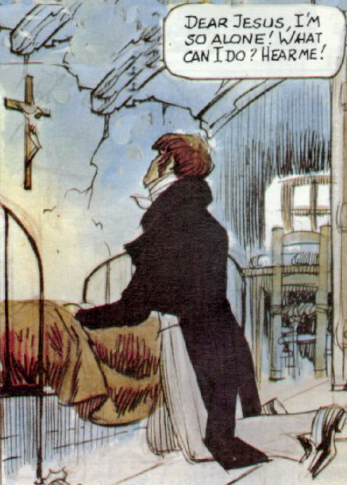
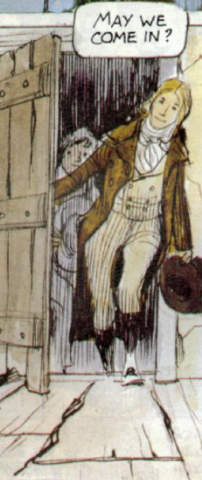

Slide 9
1808- The First Presentation Brothers

Slide 10
Why Brothers?

Slide 11
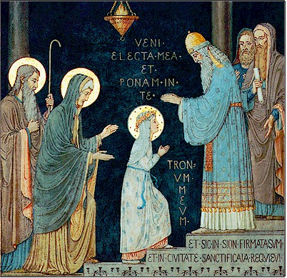
Presentation of Mary

Slide 12
Vocation in life

Slide 14
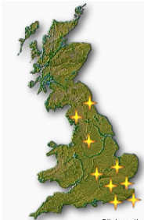

Slide 16
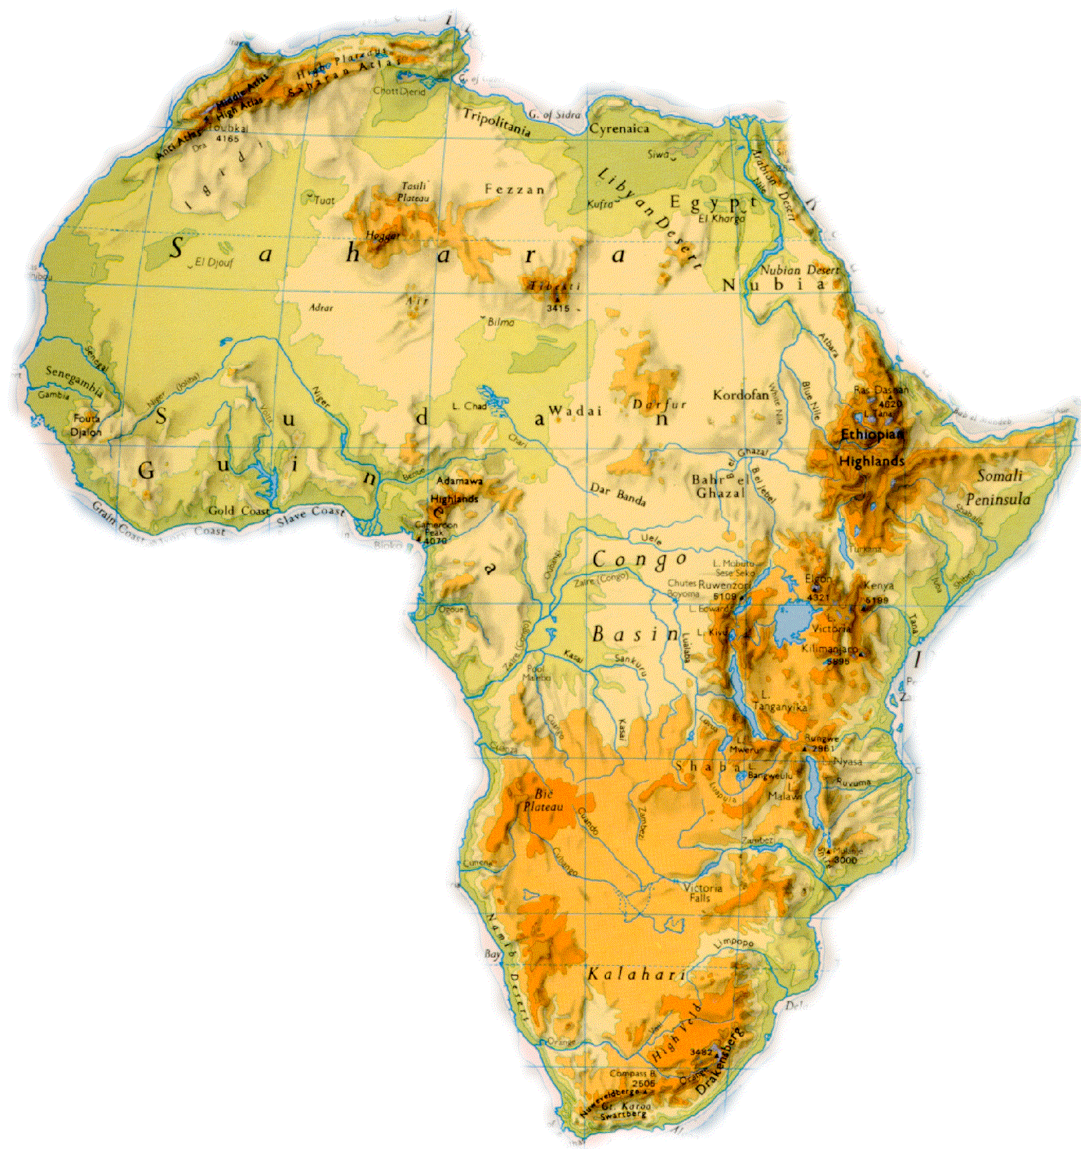

Slide 17
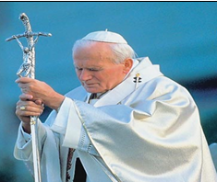
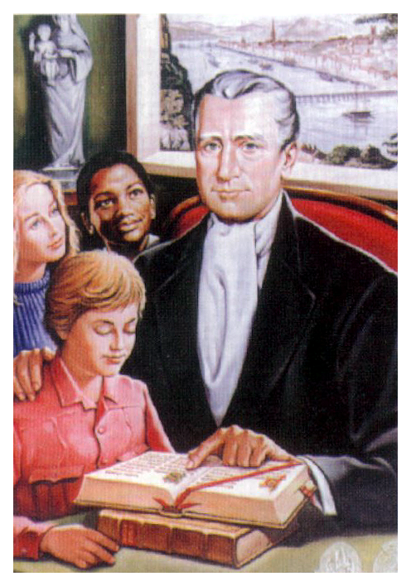
October 6th 1996

Slide 18
What is a Brother?
A Brother is…………a brother…..

Slide 19
New Missions……

Slide 20
www.PresentationBrothers.org TheBloggingBrother.blogspot.com

Slide 21
Over To You…
The Challenge….

